Slide 1


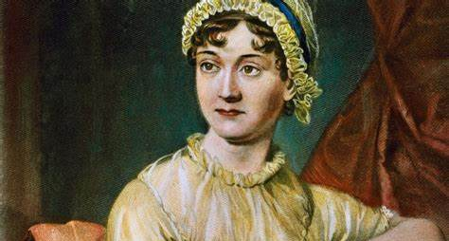
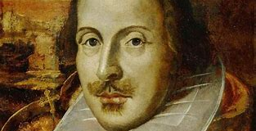
Cloning Personalities : Markov and Neural network-based Approach
Promit Haldar – 200102067

Slide 2
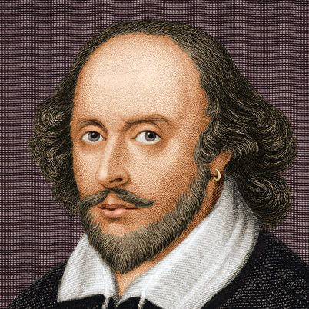
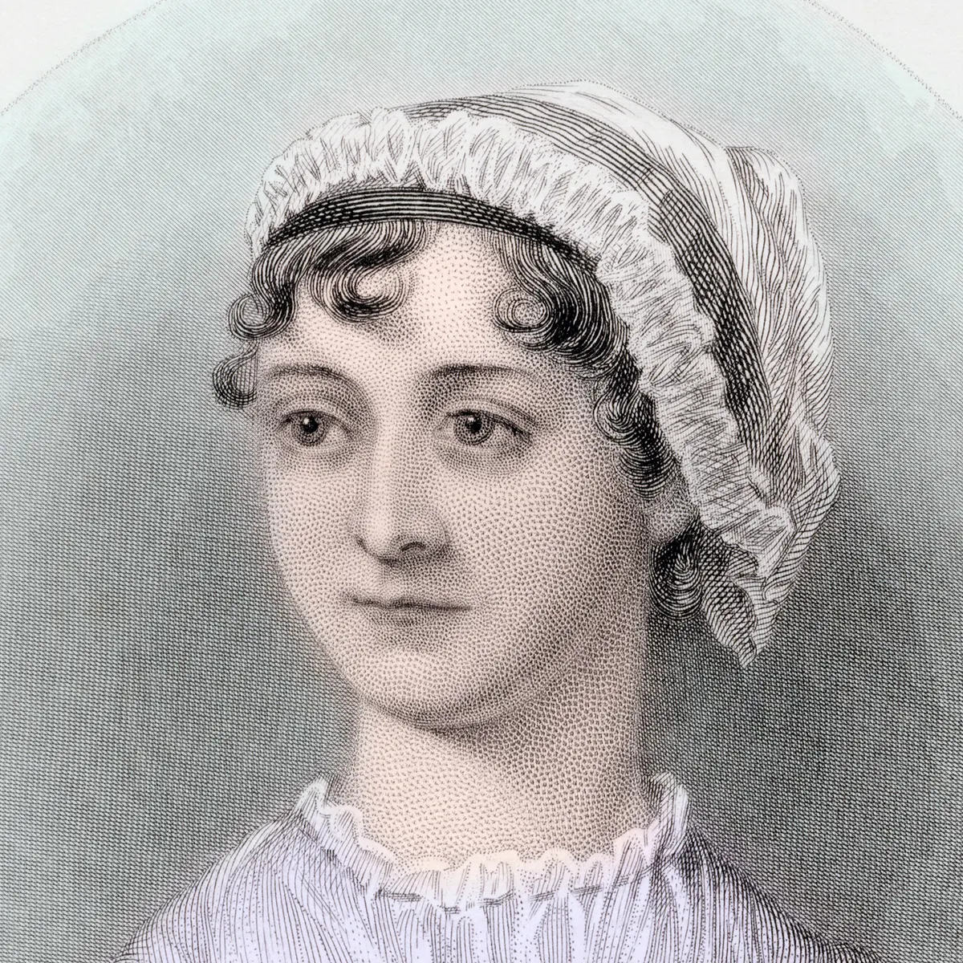




Introduction
Project Aim:
The main goal of this project is to leverage Markov model, RNN-based and advanced generative models, specifically sophisticated language models like GPT (Generative Pre-trained Transformer), to create a text-based prompt-response system, to emulate and reproduce a distinct and predefined style closely resembling the traits of a selected persona.
Problem Statement:
The challenge at hand involves training a model capable of generating text responses based on the personality of a specific well-known author or public figure. This endeavor will facilitate creative content writing, application-based tasks, and the revival of historical personalities.

Slide 3

Dataset
Introduction on author :
William Shakespeare, often regarded as the greatest playwright and poet in the English language, lived during the late 16th and early 17th centuries. His writing style is characterized by intricate plots, vivid characters, and profound insights into human nature. Shakespeare's plays, including timeless classics like "Romeo and Juliet," "Hamlet," and "Macbeth," explore themes of love, power, jealousy, and betrayal. He masterfully employed poetic devices, such as metaphors and iambic pentameter, creating rich, enduring works that continue to captivate audiences worldwide. His legacy endures through the enduring popularity of his plays and sonnets, showcasing his unparalleled talent and influence on literature.
Selected books from his works :
Comedy : {All's Well That Ends Well, As You Like It, The Merchant of Venice, etc.}
Tragedy : {Antony and Cleopatra, Hamlet, Julius Caesar, Macbeth, Othello, etc.}

Slide 4

Shakespeare’s dataset
Dataset preprocessing and source :
A dataset comprising 20 books authored by Shakespeare was curated. Text Blocks ranging from 100 to 150 words were extracted, ensuring exclusion of headers, footers, and various special indentations such as brackets, specific periods, etc. Additionally, efforts were made to enhance the dataset's suitability and robustness for training by removing character names enclosed in brackets and eliminating script and play formats from the content.
Source of the books : https://shakespeare.mit.edu/
Example of one such text block :
Thou art a Scholler; speake to it Lookes it not likNote: A hole in the page partially obscures this k.e the King? Marke it Most like: It harrowes me with fear & wonder It would be spoke too. ………………………………… How now Horatio? You tremble & look pale: Is not this something more then Fantasie? What thinke you on't? Before my God, I might not this beleeue Without the sensible and true auouch Of mine owne eyes.

Slide 5
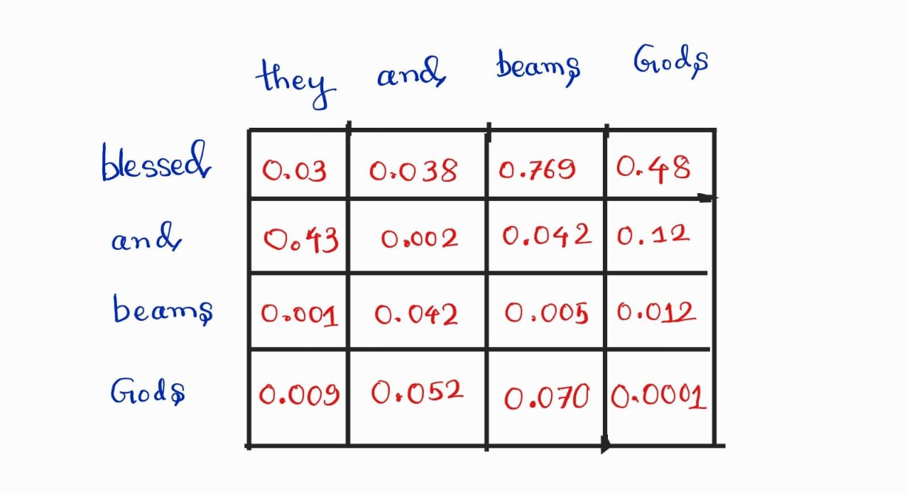
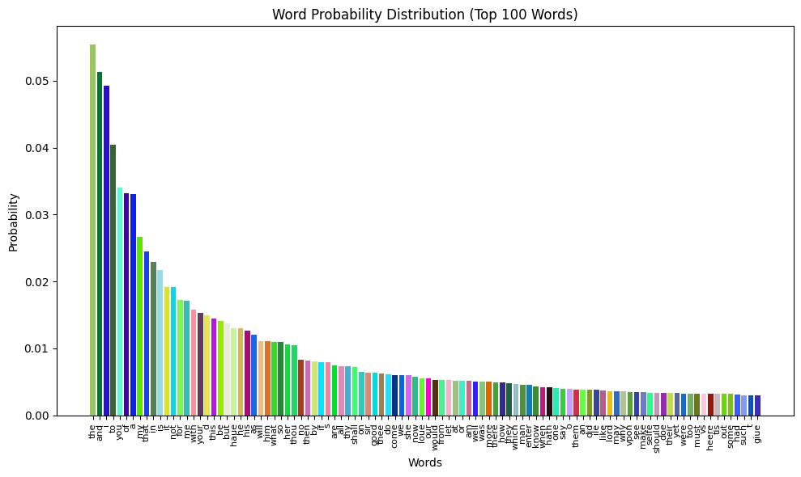
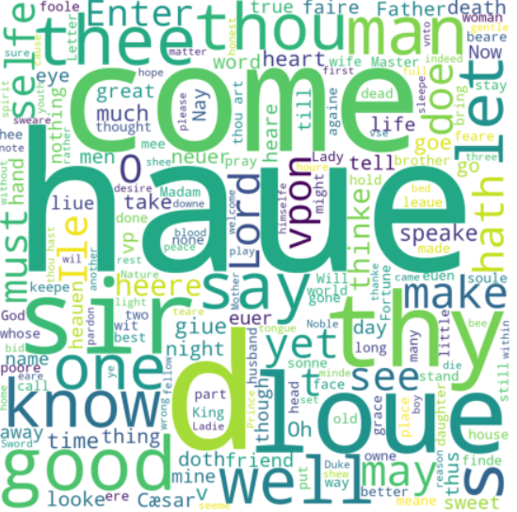
Shakespeare’s dataset analysis
Transition Matrix (small part)
Word vs Frequency

Slide 6
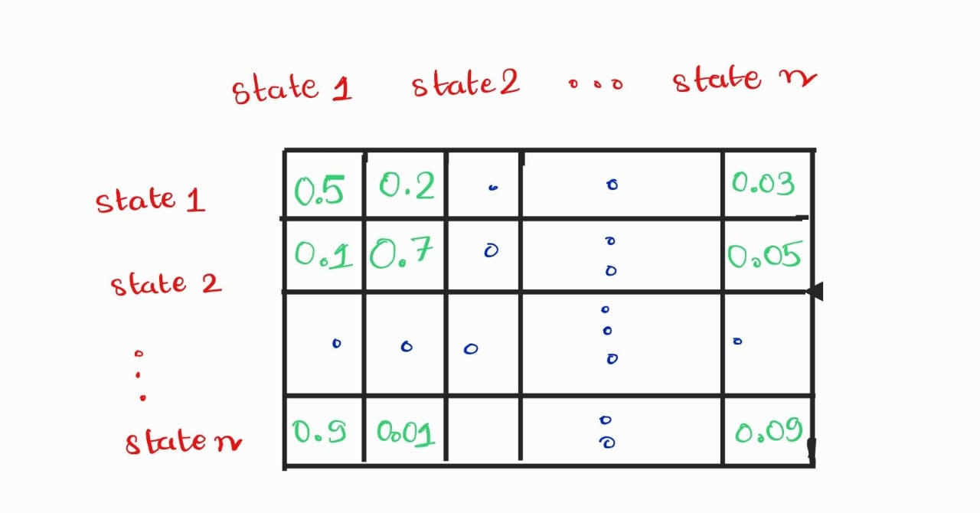
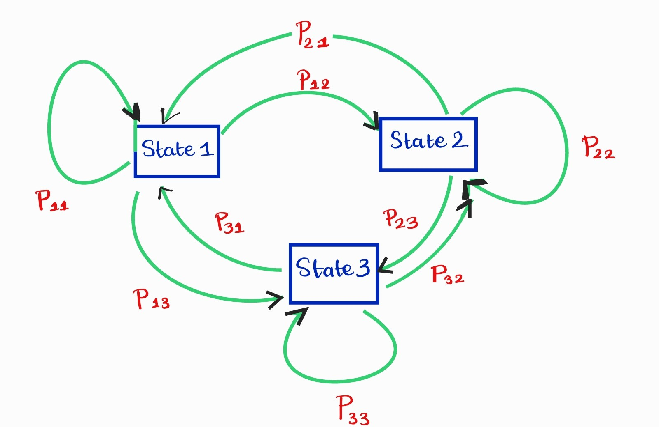
Markov Chains
Markov Chain: A Markov chain is a stochastic process in which the probability of transitioning from one state to another depends solely on the current state, with no memory of previous states.
2. Transition matrix: A 2D matrix with rows and columns as states of the Markov chain.

Slide 7
Markov Chains based implementation
a. The algorithm begins by analyzing a provided text corpus, creating a Markov Chain model. It breaks down the text into word sequences, computing the probability of each word following a specific sequence of preceding words. This information is used to construct a transition probabilities matrix for every pair of words within the entire word set.
b. To build the prediction model, users can input an initial state. If no specific word is provided, a word is randomly chosen to initiate the model training process.
c. Two primary techniques are employed to predict the next word accurately:
- Greedy Approach: This deterministic method selects the word most correlated with the last group of words using a maximum 30-order Markov Chain.
- Top-K Sampling: In this approach, the next word is randomly chosen from the 10 most correlated words of the preceding word sequence.
d. The Markov Chain's order specifies the number of preceding words considered for prediction, ranging from 2 to 30 in our approach. We incorporate the Top-K sampling method due to the occasional occurrence of infinite loops in predictions made solely using the greedy approach.
e. Using the trained model, we generated output text blocks, limiting them to a maximum of 50 words.

Slide 8
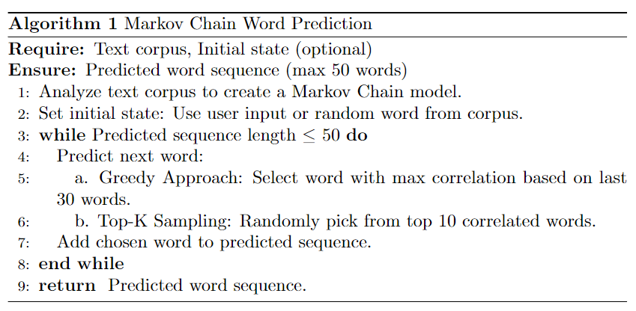
Markov Chains based implementation
Limitations :
Limited Contextual Understanding
Dependency on Training Data
Inability to Handle Out-of-Vocabulary Words
Fixed Context Window
Lack of Long-Term Dependencies
Sensitivity to Initial State
Difficulty with Ambiguity
Limited Handling of Grammar and Syntax
Difficulty with Rare Events
Vulnerability to Overfitting

Slide 9
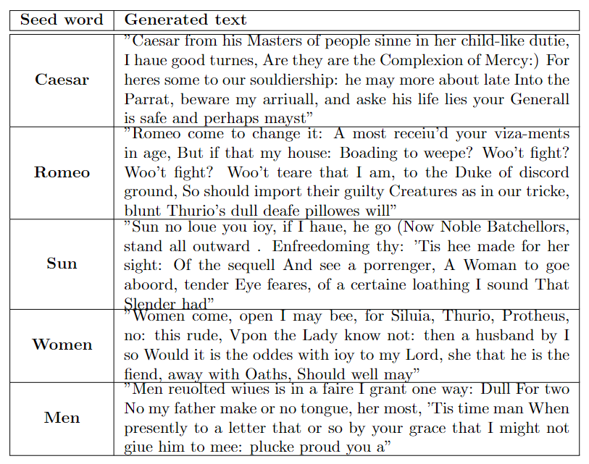
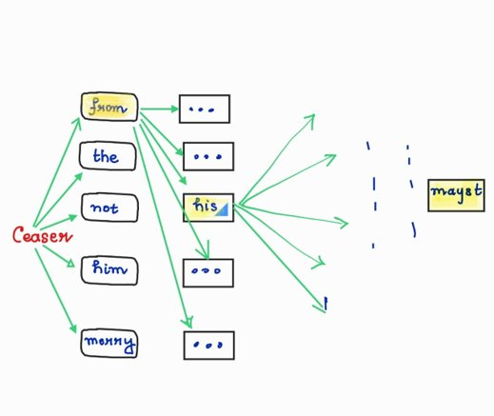
Markov implementation output
Next state generation diagram:

Slide 10
Neural Approach
LSTM
Word Embeddings
Character embedding
Generative Pre-trained Transformer

Slide 11
Word Embedding based generation
Word Embedding Matrix: The embedding layer creates a matrix where each word in the vocabulary is represented by a unique vector. These vectors have a fixed dimensionality, typically 100 to 300 dimensions, which captures the semantic meaning of words.
Word Indexing: Every word in the input text is assigned a unique index based on its position in the vocabulary. This index is used to access the corresponding vector in the embedding matrix.
Lookup Operation: The embedding layer maps words in the input text to their respective vector representations by looking up their indices in the embedding matrix. This transformation converts discrete words into continuous vector space.
Parameter Learning: During training, the embedding layer's parameters (values in the embedding matrix) are fine-tuned through backpropagation. This allows the network to adjust the word vectors based on the specific NLP task, effectively learning the semantics of the words.
Contextual and Semantic Information: The LSTM or other neural network layers receive these word vectors as input. Because of LSTM's capacity to handle sequential data, it captures not only the meaning of individual words but also their contextual relationships, enabling the network to understand and process text effectively for tasks like sentiment analysis, translation, and text generation.

Slide 12
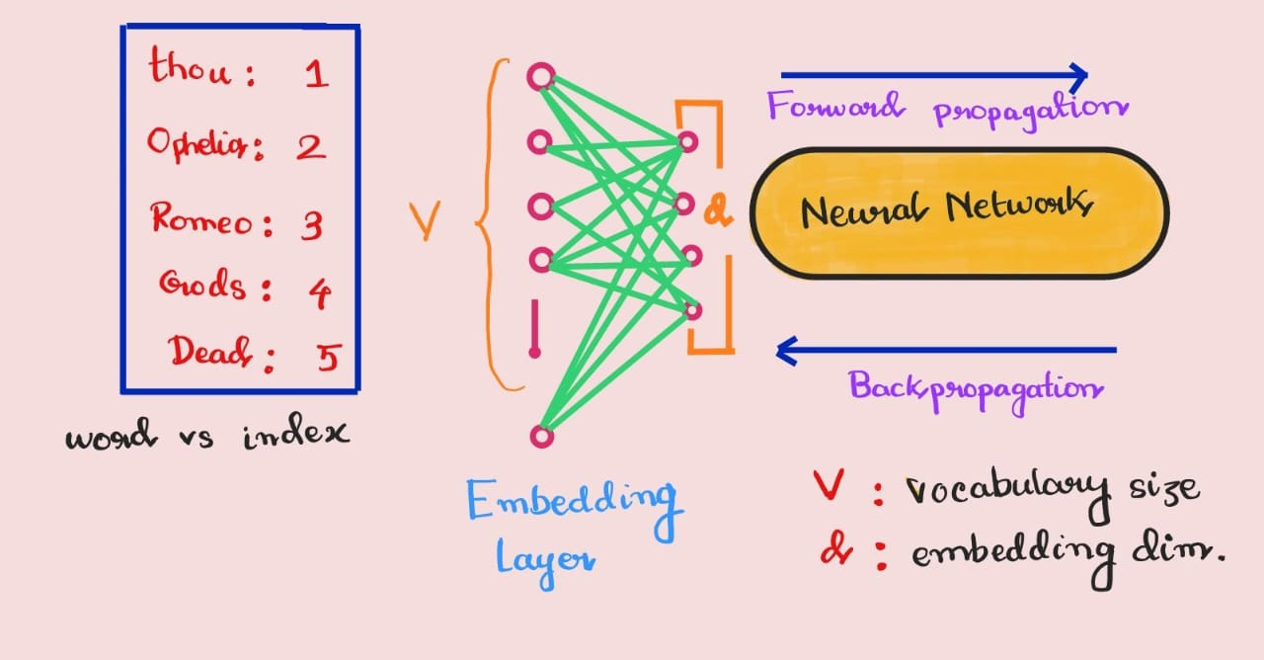

Slide 13
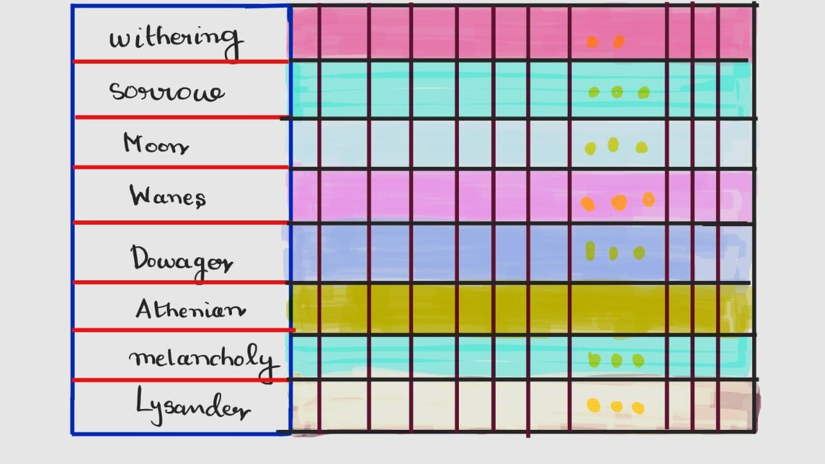

Slide 14

Character embedding based generation
Character-Level Representation: Character embedding is an approach where individual characters within words are represented as vectors. Each character in the input text, such as 'a,' 'b,' 'c,' etc., is assigned a unique vector representation.
Vector Dimensionality: Similar to word embedding, the character vectors have a fixed dimensionality (e.g., 25 dimensions). Each dimension in the vector captures certain aspects of character information.
String to Character Vectors: In this approach, words are represented as sequences of character vectors.
Learning Character Embeddings: During training, the neural network learns to create character embeddings just like word embeddings. The character vectors are updated through backpropagation, allowing the network to adapt and learn meaningful character representations for specific NLP tasks.

Slide 15

LSTM based approach
Long Short-Term Memory (LSTM) is a specialized type of recurrent neural network designed for sequential data.
Purpose: LSTMs address the vanishing gradient problem prevalent in traditional RNNs, allowing them to effectively capture long-term dependencies in data.
Processing Steps: LSTMs process sequences step by step, maintaining a hidden state and a cell state.
Gates:
Forget Gate: Determines what information to keep or discard from the cell state.
Input Gate: Decides what new information to add, updating the cell state accordingly.
Output Gate: Determines the portion of the cell state to expose as the hidden state for that step.
Summarization: LSTMs can summarize and retain relevant information within the context of the sequence being processed.
Training: LSTMs are trained through backpropagation, making them effective for tasks like natural language processing and time series analysis, where understanding context and dependencies over time is crucial.

Slide 16
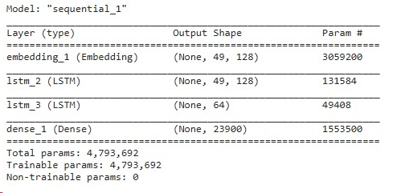
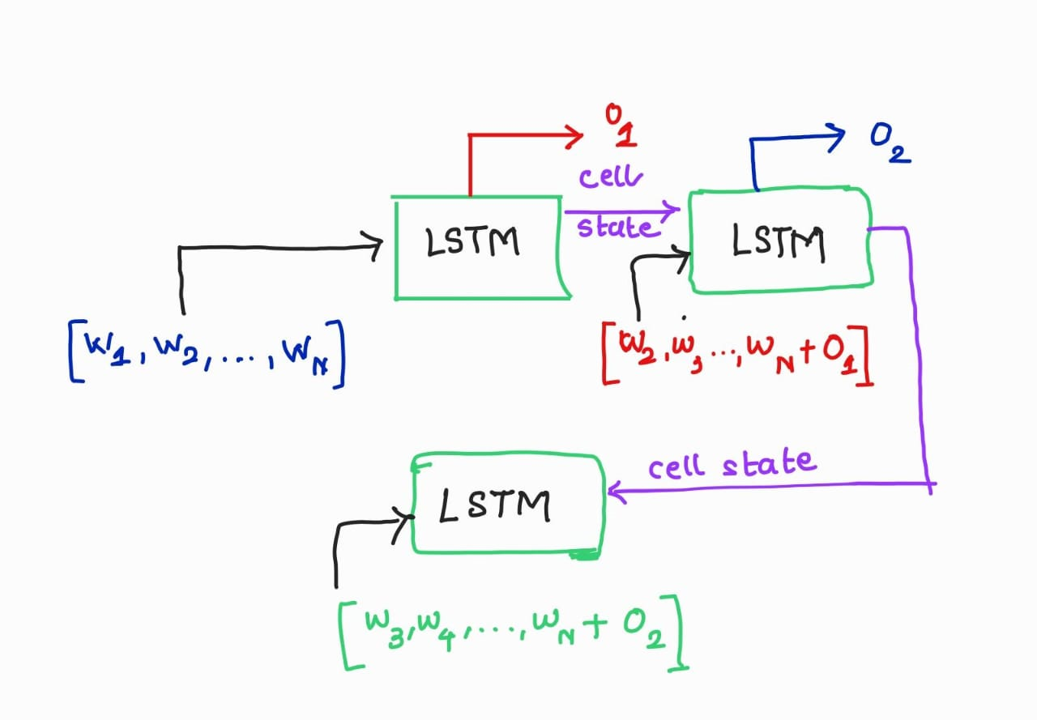
LSTM implementation

Slide 17
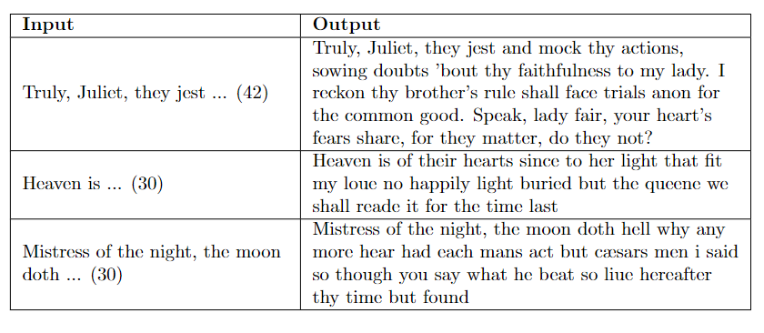
LSTM implementation output (word-embedding based)

Slide 18
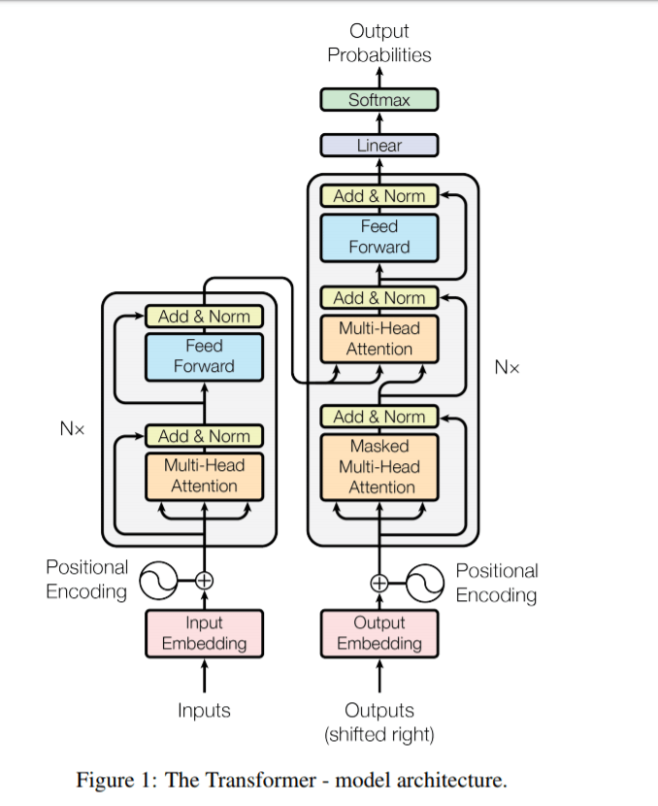
Transformer Architecture:

Slide 19
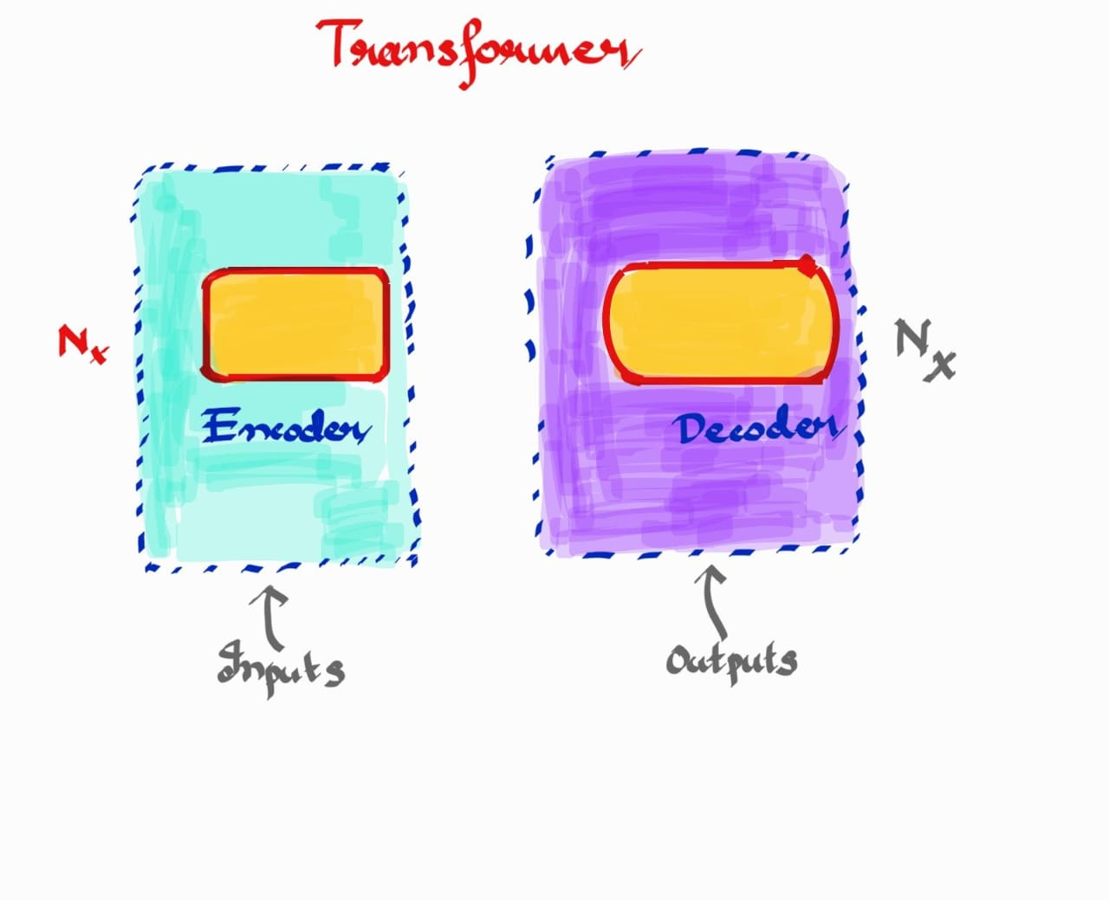
Working of Transformer
High Level View

Slide 20
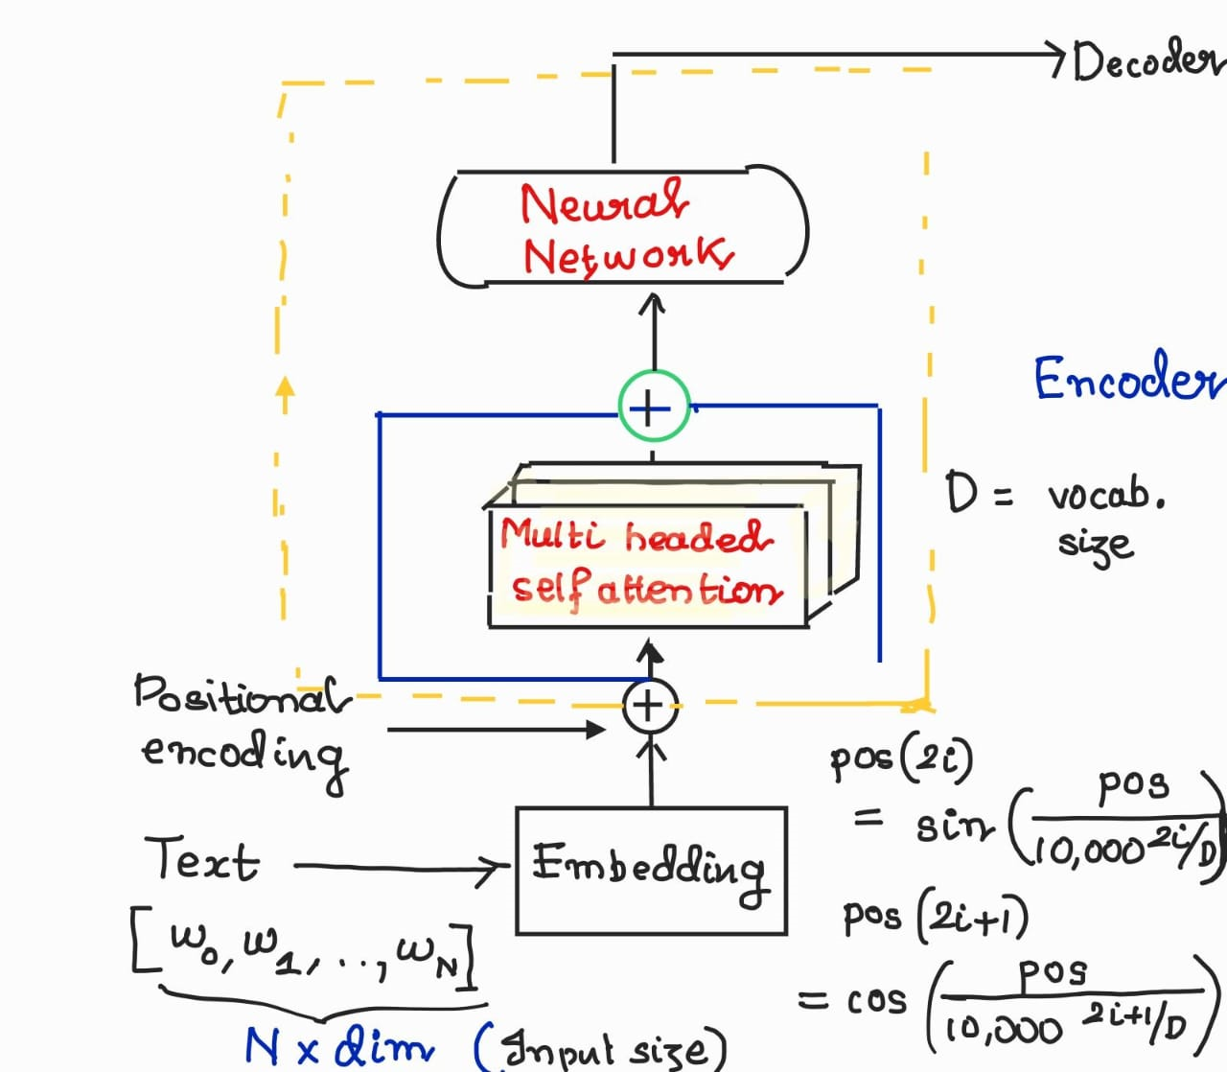
Encoder

Slide 21
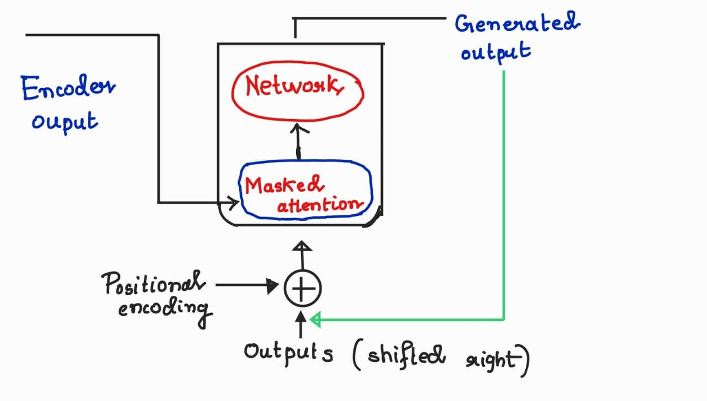
Decoder

Slide 22
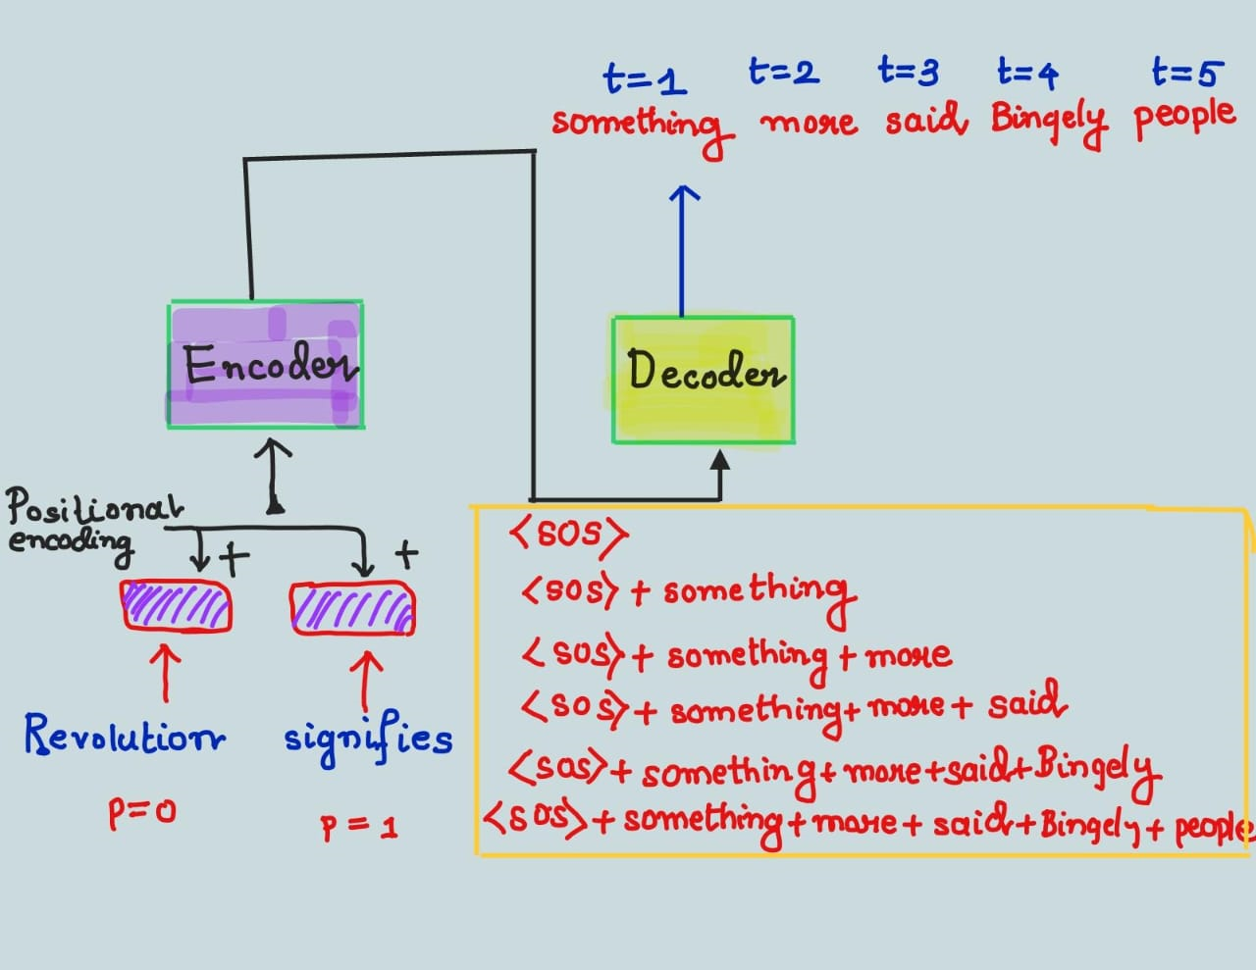
In a nutshell

Slide 23
Fine Tuning:
Fine-tuning is a machine learning technique that involves taking a pre-trained mode, and training it further on a specific task or dataset.
During fine-tuning, the model's weights are adjusted based on the new data while retaining the knowledge it acquired during its initial pre-training on a large dataset.
Fine-tuning is a crucial step in transfer learning, enabling the use of powerful, pre-trained models for various applications such as image classification, natural language processing, and more, with significantly reduced training time and resource requirements.
In our case, we fine tuned a GPT2 Model based on Jane Austen's famous novels and analyzed its performance.

Slide 24
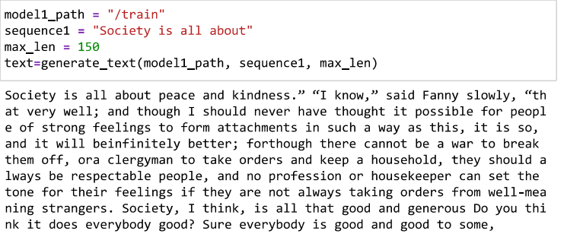
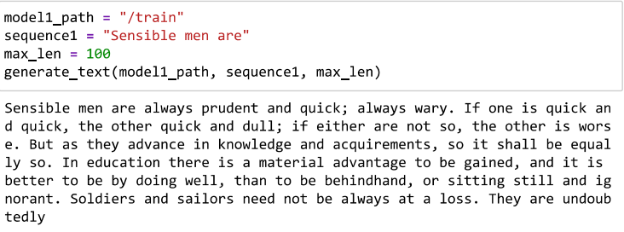
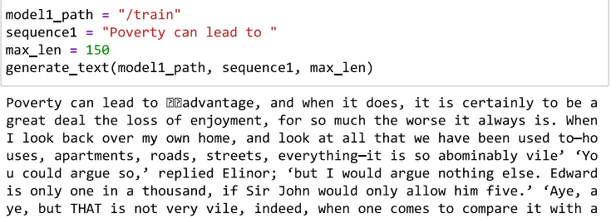
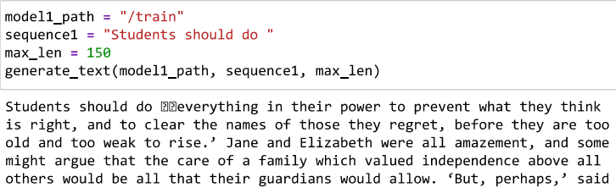
Fine Tuning Results
Shakespeare: We did not get much satisfactory result.
Jane Austin: The results were better.

